Slide 1
The Basic of JavaScript
Chapter 4

Slide 2
4.1 Overview of JavaScript
JavaScript is the world's most popular programming language of the Web.
Originally developed by Netscape, as Mocha and then renamed as LiveScript
Collections of JavaScript code is called scripts, not programs
JavaScript divided into 3 main parts:
  The core:
  The heart of the language includes Operators, expressions, and statements
  Client-side:
  collection of objects that support the control of a browser & interactions with users
  Server-side:
  collection of objects that make the language useful on a Web server
  (e.g. support communication with a database, file operations, and networking)
      → Such as VBScript and JavaScript

Slide 3
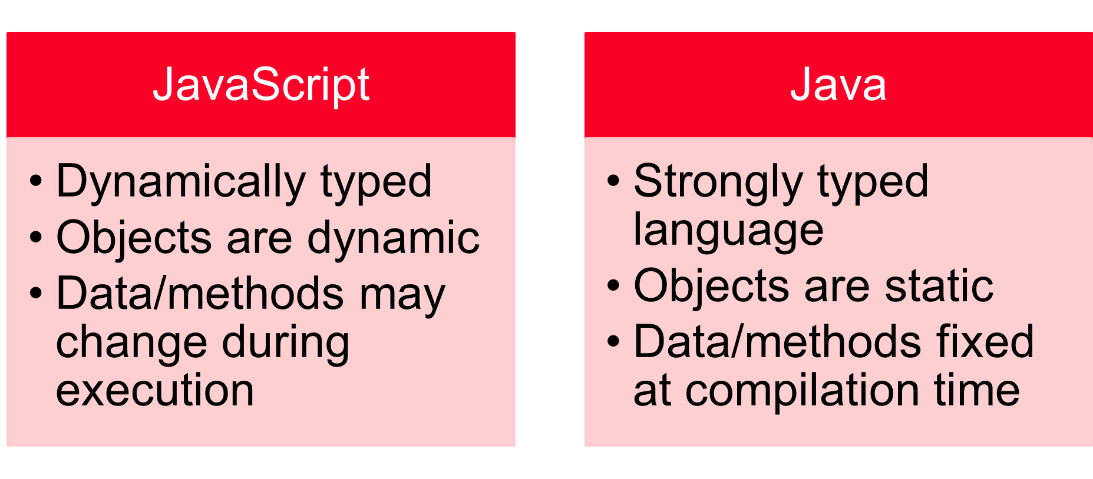
4.1 Overview of JavaScript (continued)
Java vs JavaScript:
JavaScript and Java are only related through syntax of their expressions and assignment statements

Slide 4
4.1 Overview of JavaScript (continued)
Uses of JavaScripts:
- JavaScript Objective: provide programming capability at both Sides: Server/Client ends of a Web connection
- User interactions through forms are easy to detect and control via JavaScript as well as events without forms;
e.g. moving mouse over text
- The Document Object Model (DOM) makes it possible to support dynamic HTML documents with JavaScript by changing style properties of an HTML page
- Much of what we will do with JavaScript is event-driven computation – covered in Chapter 5
JavaScript can be embedded in an HTML doc:
  Explicitly: physically resides in HTML doc.
  Implicitly: saved as external file

Slide 5
4.2 Object Orientation and JavaScript
JavaScript is NOT an object-oriented programming language
Does not support class-based inheritance
- does not have classes
JavaScript objects are collections of properties, which are like the members of classes in Java and C++.
  A property can be a data property or a method/function property
JavaScript has primitives for simple types (non-object types) →
faster as they implemented directly in hardware

Slide 6
4.3 General Syntactic Characteristics
In the textbook, all JavaScript scripts are embedded in HTML documents
Either directly, as in
<script type = "text/javaScript">
-- JavaScript script –
</script>
Or indirectly, as a file specified in the src attribute of <script>, as in
<script type = "text/javaScript“ src = "myScript.js">
</script>

Slide 7
Usage Examples for JavaScript
JavaScript Can Change HTML Content
    document.getElementById("demo").innerHTML = "Hello JavaScript";
JavaScript Can Change HTML Attribute Values
  In this example JavaScript changes the value of the src (source) attribute of an <img> tag
JavaScript Can Change HTML Styles (CSS)
    document.getElementById("demo").style.fontSize = "35px";
JavaScript Can Show or Hide HTML Elements
    document.getElementById("demo").style.display = "none"; //Hide
    document.getElementById("demo").style.display = "block"; //Show

Slide 8
Example of the JavaScript code
1.javaScript Can Change HTML Content
<!DOCTYPE html>
<html>
<body>
<h2>What Can JavaScript Do?</h2>
<p id="demo">JavaScript can change HTML content.</p>
<script type="text/Javascript">
document.getElementById("demo").innerHTML = "Hello JavaScript!";
</script>
</body>
</html>

Slide 9
Example of the JavaScript code
2.JavaScript Can Change HTML Attribute Values
<!DOCTYPE html>
<html>
<body>
<h2>What Can JavaScript Do?</h2>
<p>JavaScript can change HTML attribute values.</p>
<p>In this case JavaScript changes the value of the src (source) attribute of an image.</p>
<button onclick="document.getElementById('myImage').src='pic_bulbon.gif'">Turn on the light</button>
<img id="myImage" src="pic_bulboff.gif" style="width:100px">
<button onclick="document.getElementById('myImage').src='pic_bulboff.gif'">Turn off the light</button>
</body>
</html>

Slide 10
Example of the JavaScript code
3. JavaScript Can Change HTML Styles (CSS)
<!DOCTYPE html>
<html>
<body>
<h2>What Can JavaScript Do?</h2>
<p id="demo">JavaScript can change the style of an HTML element.</p>
<button type="button" onclick="document.getElementById('demo').style.fontSize='35px'">Click Me!</button>
</body>
</html>

Slide 11
Example of the JavaScript code
4. JavaScript Can Show or Hide HTML Elements
<!DOCTYPE html>
<html>
<body>
<h2>What Can JavaScript Do?</h2>
<p>JavaScript can show hidden HTML elements.</p>
<p id="demo" style="display:none">Hello JavaScript!</p>
<button type="button" onclick="document.getElementById('demo').style.display='block'">Click Me!</button>
</body>
</html>

Slide 12
Example – Function
<!DOCTYPE html>
<html>
<head>
<script type="text/javascript">
function change(){
document.getElementById("demo").innerHTML = "Hello JavaScript!";
}
</script>
</head>
<body>
<h2>What Can JavaScript Do?</h2>
<p id="demo">JavaScript can change HTML content.</p>
<button type="button" onclick="change()">Click Me!</button>
</body>
</html>

Slide 13
4.3 General Syntactic Characteristics
- Language Basics:
- Identifier form:
    Variable names must begin with a letter, an underscore (_) or a dollar sign ($)
    Variable names can only contain letters, numbers, underscores, or dollar signs.
    Variable names are case-sensitive.
- 25 reserved words, plus future reserved words
https://www.w3schools.com/js/js_reserved.asp
- Comments: same as that in Java using both // and /* … */

Slide 14
4.3 General Syntactic Characteristics (continued)
- Scripts are usually hidden from browsers that do not include JavaScript interpreters by putting them in special comments; why?
<!--
-- JavaScript script –
//--> in separate line unlike normal HTML comment
double backslash are a MUST
- Also required by the XHTML validator
If not detected by browser it will be displayed on the page
Check version/validator of XHTML via tools → options → Text editor → HTML → validation

Slide 15
4.3 General Syntactic Characteristics (continued)
-- Semicolons can be a problem
- They are “somewhat” optional
- Problem: When the end of the line can be the end
of a statement – JavaScript puts a semicolon there
example: return x;
return // interpreter adds ; here
x; // makes next line invalid

Slide 16
4.4 Primitives, Operations, & Expressions
- All primitive values have one of the five primitive types:
Number, String, Boolean, Undefined, or Null
- Number, String, and Boolean have wrapper objects
(Number, String, and Boolean)
  - i.e. each contains a property that stores a value of the corresponding primitive type.
- Numeric literals – just like Java
- All numeric values are stored in double-precision floating point
- String literals are delimited by either ' or "
- Can include escape sequences (e.g., \t)
- All String literals are primitive values

Slide 17
4.4 Primitives, Operations, & Expressions (continued)
Boolean values are true and false
The only Null value is null
The only Undefined value is undefined;
a variable declared but not assigned a value
JavaScript is dynamically typed – any variable can be used for anything (primitive value or reference to any object)
The interpreter determines the type of a particular occurrence of a variable
Variables can be either implicitly or explicitly declared

Slide 18
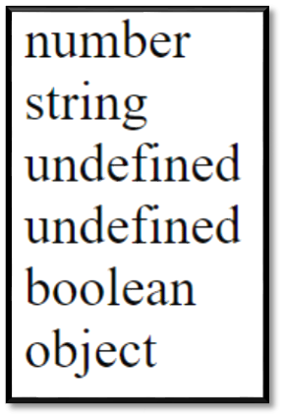
4.4 Primitives, Operations, & Expressions (continued)
- The typeof operator always return string value:
- Returns "number", "string", or "boolean" for Number, String, or
Boolean,
- Returns "undefined" for Undefined,
- Returns "function" for functions, and
- Returns "object" for objects and NULL
typeof x and typeof(x)are equivalent
var sum = 0, today = "Monday",
n1 = undefined, counter, //no value is undefined
flag = false, value = null;
document.write(typeof sum + "<br>" + typeof today + "<br>"+
typeof n1 +"<br>" + typeof counter + "<br/>"+
typeof flag+"<br>" + typeof value );

Slide 19
4.4 Primitives, Operations, & Expressions (continued)
- Assignment statements – just like C++ and Java e.g. a += 7
- Numeric operators - ++, --, +, -, *, /, %
- All operations are in double precision
- Same precedence and associativity as Java/Python
- The Math Object provides floor, round, max, min, functions, etc.
e.g., Math.cos(x)
- The Number Object e.g., Number.MAX_VALUE
- Some useful properties: MAX_VALUE, MIN_VALUE, NaN, POSITIVE_INFINITY,
NEGATIVE_INFINITY, PI
- An arithmetic operation that creates overflow or division by zero error
returns NaN value
- NaN is not == to any number, not even itself
- Test for it with isNaN(x) function
The NaN property represents "Not-a-Number" value.
  This property indicates that a value is not a legal number.
Like Java

Slide 20
4.4 Primitives, Operations, & Expressions (continued)
Number object has the method, toString method
To convert from number primitive to string
  Var price= 427, str_price;
  Str_price = price.toString(); //OR Str_price = String(price);
Strings: not stored as arrays of char.
- String catenation operator +
- Coercions (implicit conversion)
- Catenation coerces numbers to strings
- Numeric operators (other than +) coerce strings to numbers (if either operand of + is a string, it is assumed to be catenation)
- Conversions from strings to numbers that do not work return NaN
Examples:
“August ” + 1977 = “August 1977”
“3” * 7 = 21
“Oct” * 7 = NaN
null + 6 = 6 (null == 0)

Slide 21
4.4 Primitives, Operations, & Expressions (continued)
- Explicit conversions
1. Use the String and Number constructors
e.g. var s_v = String(6); // “6”
var num = Number(s_v); // same as s_v
var num = aString – 0 // by subtracting or 0 from aString
2. Use toString method of numbers; can specify the base of the number
e.g. num = 6;
var s_v = num.toString(); //base10
var s_v_binary = num.toString(2); result = 110 //base 2

Slide 22
4.4 Primitives, Operations, & Expressions (continued)
3. Use parseInt and parseFloat on strings
parseInt(sValue, radix) starts with int,
parseInt('0101'); // 101
parseInt('0101', 10); // 101
parseInt('0101', 2); // 5
parseInt("22.5"); //returns 22
parseFloat(sValue) search for decimal point
parseFloat('3.14'); parseFloat(' 3.14 '); parseFloat("1234blue"); //returns 1234
- String properties & methods:
- length e.g., var len = str1.length; (a property)
- charAt(position) e.g., str.charAt(3)
- indexOf(string) e.g., str.indexOf('B')
- substring(from, to) e.g., str.substring(1, 3)
- toLowerCase() e.g., str.toLowerCase()
Like Java

Slide 23
4.4 Primitives, Operations, & Expressions (continued)
- The Date Object
- There are 4 ways to create a new date object
new Date() // Current date and time
    new Date(year, month, day, hours, minutes, seconds, milliseconds)
    // months from 0 to 11
    new Date(milliseconds)
    new Date(date string)
e.g. var today = new Date( );
var d = new Date("October 13, 2021 11:13:00");
var d = new Date("2021-03-10");
- Displaying Dates
d.toString();
d.toDateString();
d.toUTCString();

Slide 24
4.4 Primitives, Operations, & Expressions (continued)
Get Date Methods
- Used for getting information from a date object see page (156)
Method | Description
getFullYear() | Get the year as a four digit number (yyyy)
getMonth() | Get the month as a number (0-11)
getDate() | Get the day as a number (1-31)
getHours() | Get the hour (0-23)
getMinutes() | Get the minute (0-59)
getSeconds() | Get the second (0-59)
getMilliseconds() | Get the millisecond (0-999)
getTime() | Get the time (milliseconds since January 1, 1970)
getDay() | Get the weekday as a number (0-6)
Date.now() | Get the time.

Slide 25
Set Date Methods
Set Date methods are used for setting a part of a date
Method | Description
setDate() | Set the day as a number (1-31)
setFullYear() | Set the year (optionally month and day)
setHours() | Set the hour (0-23)
setMilliseconds() | Set the milliseconds (0-999)
setMinutes() | Set the minutes (0-59)
setMonth() | Set the month (0-11)
setSeconds() | Set the seconds (0-59)
setTime() | Set the time (milliseconds since January 1, 1970)

Slide 26
4.5 Screen Output & Keyboard Input
- The model for the browser display window is the Window object
  - The Window object has two properties, document and window, which refer to the Document and Window objects, respectively
  - The Document object has a method, write, which dynamically creates content
  - The parameter is a string, often concatenated from parts, some of which are variables
  e.g., document.write("Answer: " + result + "<br />");
  - The parameter is sent to the browser, so it can be anything that can appear in an HTML
  document.write ("<br />, but not \n");

Slide 27
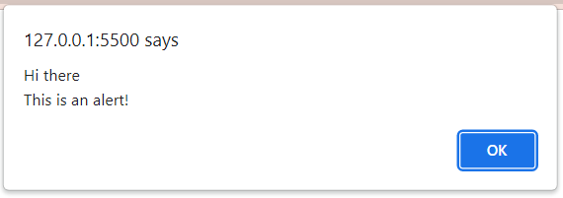
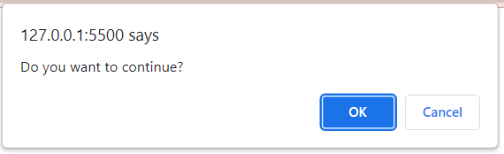
4.5 Screen Output (continued)
- The Window object has three methods for creating dialog boxes, alert, confirm, and prompt
1. alert("Hi there \nThis is an alert!");
- Parameter is plain text, not HTML
- Opens a dialog box which displays the parameter string and an OK button
- It waits for the user to press the OK button
2. confirm("Do you want to continue?");
- Opens a dialog box and displays the parameter and two buttons, OK and
Cancel
- Returns a Boolean value (true/false), depending on which button was pressed (it waits for
one)

Slide 28
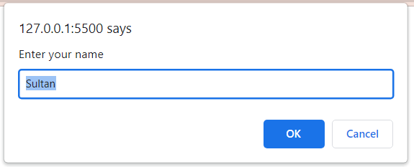
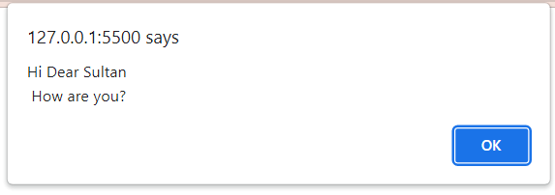
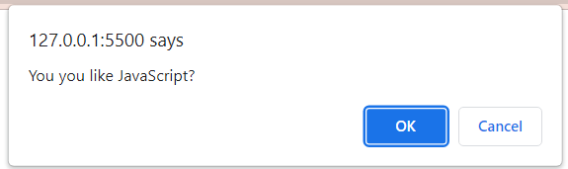
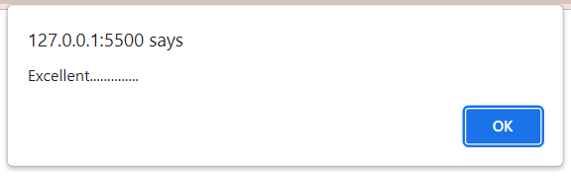
4.5 Screen Output (continued)
3. prompt("What is your name?", “Sultan");
  Opens a dialog box and displays its string parameter, along with a text box and two buttons, OK and Cancel
  The second parameter is for a default response if the user presses OK without typing a response in the text box (waits for OK)
<script type="text/Javascript">
var name=prompt("Enter your name",“Sultan");//you can use HTML elements
alert("Hi Dear "+name+"\n How are you?"); //no HTML
if (confirm("You you like JavaScript?"))
alert("Excellent..............");
else
alert("You need to try more JS programs");
var result= 2 * 8;
document.result("<h1> Result="+result+"<h1/>");
</script>

Slide 29
4.6 Control Statements (continued)
- Loop statements
while (control_expression) statement or cmpnd
for (init; control; increment) statement or cmpnd
- init can have declarations, but the scope of such variables is the
whole script
do
statement or compound
while (control_expression)
Like Java

Slide 30
For loops
var list=[5,2,7,9,1,4,6];
1- for loop
  for(var i=0; i<list.length;i++)
  document.write(" "+list[i]);
2- for in loop
  for(var i in list)
  document.write(" "+list[i]);
3- for of loop
for(var x of list)
document.write(" "+x);

Slide 31
4.6 Control Statements
- Similar to C, Java, and C++
Compound statements are delimited by braces, but compound statements are not blocks
- Control expressions – three kinds
1. Primitive values if (0)
- If it is a string, it is true unless it is empty or "0"
- If it is a number, it is true unless it is zero

Slide 32
4.6 Control Statements
2. Relational Expressions
- The usual six : ==, !=, <, >, <=, >=
- Operands are coerced if necessary
- If one is a string and one is a number,
it attempts to convert the string to a number
- If one is Boolean and the other is not,
the Boolean operand is coerced to a number (1 or 0)
- The unusual two: === and !==
- Same as == and !=, except that no coercions are done
(operands must be identical)
“37” === 37 → false
“37” == 37 → true
true > 37 → false

Slide 33
4.6 Control Statements (continued)
2. Relational Expressions (continued)
- Comparisons of references to objects are not useful (addresses are
compared, not values)
3. Compound Expressions
- The usual operators: &&, ||, and !
- The Boolean object has a method, toString, to allow them to be printed (true or false)
- If a Boolean object is used in a conditional expression, it evaluates to true if it has any
value other than null or undefined
- Selection Statements
- The usual if-then-else (clauses can be either single statements or compound statements)
Like Java

Slide 34
4.6 Control Statements (continued)
- Switch
switch (expression) {
case value_1:
// value_1 statements
break;
case value_2:
// value_2 statements
break;
…
[default:
// default statements]
}
- The statements can be either statement sequences or compound statements
- The control expression can be a number, a string, or a Boolean
- Different cases can have values of different types
//Example
var text =" ";
switch (new Date().getDay()) {
case 5:
text = " Today is Friday";
case 6:
text += "It is weekend";
break;
case 0:
case 4:
text = “First or last working day";
break;
default:
text = “Other working day";
}
Like Java

Slide 35
4.7 Object Creation and Modification
- In JavaScript, almost "everything" is an object
  Including primitive types (number, string, Boolean,..), Methods, Dates, Math, Arrays, and Objects
- Objects can be created with new
- The most basic object is one that uses the Object
constructor, as in
var myObject = new Object();
- The new object has no properties - a blank object
- Properties can be added to an object, any time

Slide 36
4.7 Object Creation and Modification (continued)
var myAirplane = new Object();
myAirplane.make = "Cessna";
myAirplane.model = "Centurian";
myAirplane.year = 2022;
myAirplane.color = “green”;
- Properties can be accessed by dot notation or in array notation, as in
delete myAirplane.model; //dot notation
var property1 = myAirplane["model"]; //array
- Another Loop Statement (an iterator)
for (identifier in object) statement or compound
for (var x in myAirplane)
document.write(myAirplane[x] + "<br />");

Slide 37
Object Literal
Using an object literal, you both define and create an object in one statement.
An object literal is a list of name:value pairs (like age:50) inside curly braces {}.
Example:
var myAirplane = {make:"Cessna", model:"Centurian", year:2022, color:“green"};

Slide 38
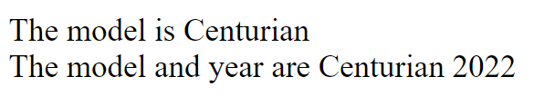
Object Methods
JavaScript methods are actions that can be performed on objects.
  this keyword refers to an object.
var myAirplane = {
make:"Cessna", model:"Centurian", year:2022, color:"green",
getModelYear: function()
{ return this.model+" "+this.year;}
};
document.write("<br/>The model is "+myAirplane.model);
document.write("<br/>The model and year are "+myAirplane.getModelYear());

Slide 39
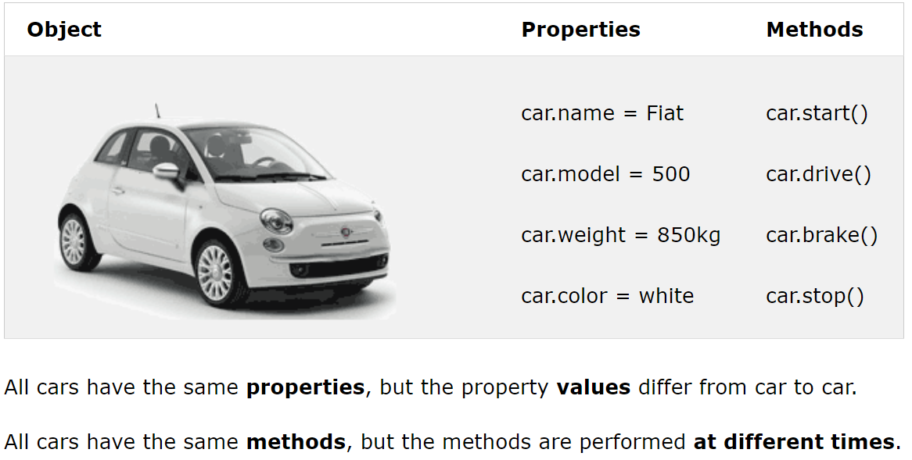
JavaScript Objects

Slide 40
4.11 Constructors
- Used to initialize objects, but actually create the properties
function plane(newMake, newModel, newYear){
this.make = newMake; this.model = newModel;
this.year = newYear;
}
myPlane = new plane("Cessna","Centurian","1970");
- Can also have method properties
function displayPlane() {
document.write("Make: ", this.make, "<br />");
document.write("Model: ", this.model,"<br />");
document.write("Year: ", this.year, "<br />");
}
- Now add the following to the constructor:
this.display = displayPlane; //method can be a Called by myPlane.display()
var myAirplane = new Object();
myAirplane.make = "Cessna";
myAirplane.model = "Centurian";
myAirplane.color = “green”;

Slide 41
Object Constructors – Example
// Constructor function for Person objects
function Person(first, last, age, eye) {
this.firstName = first;
this.lastName = last;
this.age = age;
this.eyeColor = eye;
}
// Create a Person object
const myFriend = new Person(“Khamis", “Salem", 50, "blue");
// Display age
document.write("<br/> My father is " + myFriend.age + ".");

Slide 42
Object Constructor with Methods
You cannot add a new method to an object constructor the same way you add a new method to an existing object
// Constructor function for Person objects
function Person(first, last, age, eye) {
this.firstName = first;
this.lastName = last;
this.age = age;
this.eyeColor = eye;
this.name = function() {
return this.firstName + " " + this.lastName
};
}
// Create a Person object
const myFather = new Person("Ali", "Al-Rashdi", 50, "blue");
// Display name
document.write("<br/> My father is " + myFather.name() + ".");

Slide 43
4.8 Arrays
- Objects with some special functionality
- Array elements can be primitive values or references to other objects
- Length is dynamic - the length property stores the length
Array objects can be created in two ways, with new, or by assigning an array literal
//both myList and myList2 have the same values
const myList = new Array(24, "bread", true);
const myList2 = [24, "bread", true];
//Creates an array of 5 undefined elements
const myList3 = new Array(5);

Slide 44
Const Arrays
In 2015, JavaScript introduced new key words (e.g. const, let)
  It is a common practice to declare arrays with the const keyword.
An array declared with const cannot be reassigned
  const cars = ["Saab", "Volvo", "BMW"];
  cars = ["Toyota", "Volvo", "Audi"]; // ERROR - must be initialized when it is declared
  const cars = ["Toyota", "Volvo", "Audi"]; // ERROR – cannot re-declare array
  var cars = ["Saab", "Volvo", "BMW"];
  cars = ["Toyota", "Volvo", "Audi"]; // no problem
  var cars = ["Toyota", "Volvo", "Audi"]; // no problem
Elements Can be Reassigned
  // You can create a constant array:
  const cars = ["Saab", "Volvo", "BMW"];
  // You can change an element:
  cars[0] = "Toyota";

Slide 45
4.8 Arrays
- The length of an array is the highest subscript to
which an element has been assigned, plus 1
myList[122] = "bitsy"; // length is 123
- Because the length property is writeable, you can
set it to make the array any length you like, as in
myList.length = 150;
- Assigning a value to an element that does not exist
creates that element

Slide 46
4.8 Arrays (continued)
Assume:
const names = new Array[“Aisha”, “Sara”, “Khalid”];
- Array methods:
- join – e.g., var listStr = names.join(“: ");
//results listStr= “Aisha: Sara: Khalid”
- reverse
e.g. var rev = names.reverse();
//results rev = [“Khalid”, “Sara”, “Aisha”]
- sort – e.g., names.sort();
- Coerces elements to strings and puts them in alphabetical order
//results names= [“Aisha”, “Khalid”, “Sara”]
- concat
e.g., var newNames = names.concat(“Ali”, “Ahmed”);
//results newNames of length 5; where
newNames = [“Aisha”, “Khalid”,”Sara”,“Ali”,“Ahmed”]

Slide 47
4.8 Arrays (continued)
- Array methods:
- slice: Similar to substring method in String
e.g.; const nums = [1, 23, 45, 56, 64, 102, 200];
var midNums = nums.slice(2, 5);
var part2 = list.slice(4);
results: midNums = [45, 56, 64]
part2 = [64, 102, 200]
- toString (exactly like join(", "))
- Coerce elements to strings, if necessary, and catenate them together,
separated by commas
- push, add element to the end of list
- pop, remove element from end of list
- unshift, and shift
unshift: add element to beginning of list
shift: remove element from beginning of list
// You can create a constant array:
const cars = ["Saab", "Volvo", "BMW"];
// You can change an element:
cars[0] = "Toyota";
// You can add an element:
cars.push("Audi");

Slide 48
4.9 Functions
function function_name([formal_parameters]) {
-- body –
}
- Return value is the parameter of return
- If there is no return, or if the end of the function is reached, undefined is returned
- If return has no parameter, undefined is returned
- Functions are objects, so variables that reference them can be treated as other object references
- If fun is the name of a function,
function fun() {document.write(“testing”);}
ref_fun = fun; /* refers to fun object*/
fun(); /* call to fun */
ref_fun(); /* A call to fun */
- We place all function definitions in the head of the the XHTML document
- All variables that are either implicitly declared or explicitly declared outside functions are global
- Variables explicitly declared inside a function are local

Slide 49
4.9 Functions (continued)
Parameters are passed by value, but when a reference variable is passed, the semantics are pass-by-reference (as an object)
There is no type checking of parameters, nor is the number of parameters checked (additional actual parameters are ignored, extra formal parameters are set to undefined)
All parameters are sent through a property array, arguments, which has the length property
i.e. arguments.length /*to identify # of parmt*/

Slide 50
4.9 Functions (continued)
- There is no clean way to send a primitive (single value) by reference
- One dirty way is to put the value in an array and send the array’s name
function by10(a) {
a[0] *= 10;
}
...
var listx = new Array(1);
...
listx[0] = x;
by10(listx);
x = listx[0];

Slide 51
4.9 Functions (continued)
Sorting
To sort something other than strings into alphabetical order, write a function that performs the comparison and send it to the sort method
The compare function must return a negative number, zero, or a positive number to indicate whether the order is ok, equal, or not
function num_order(a, b) {return a - b;}
- Now, we can sort an array named num_list into descendent order:
num_list.sort(num_order);
- How we can sort list in decreasing order?

Slide 52

Example - Sorting
function sortDESC(a,b){ return b-a;}
function sortASC(a,b){ return a-b;}
var list=[5,2,7,9,1,4,6];
document.write("<br/> Elements in ascendant order are ")
list.sort(sortASC);
for(var x in list) document.write(" "+list[x])
document.write("<br/> ");
document.write("<br/> Elements in descendent order are ")
list.sort(sortDESC);
for(var x in list) document.write(" "+list[x])
document.write("<br/> ");

Slide 53
Example
<script type="text/javascript">
function Student(fn,ln,gpa){this.fname=fn; this.lname=ln; this.GPA=gpa; }
function sortStudents(s1,s2){
if(s1.lname == s2.lname){
if(s1.fname>s2.fname) return -1;
else if(s1.fname<s2.fname) return 1;else return 0;
}
else{
if(s1.lname > s2.lname) return -1; else return 1;
}
}
const myclass = [ new Student("Iman","AAA",3.5),new Student("Ahmed","AAA",3.5),
new Student("Saleh","BBB",3.5)];
myclass.sort(sortStudents);
myclass.pop();
myclass.unshift(new Student("xxx","yyy",3.9));
for(var x of myclass){
document.write("<br/>"+x.fname+" "+x.lname+" has a GPa of "+x.GPA);
}
</script>

Slide 54
4.12 Pattern Matching
- JavaScript provides two ways to do pattern matching:
1. Using RegExp objects
2. Using methods on String objects
- Simple patterns (e.g. using search method)
- Two categories of characters in patterns:
  Normal characters (match themselves)
  Metacharacters (can have special meanings in patterns - do not match themselves)
\ | ( ) [ ] { } ^ $ * + ? .
- A metacharacter is treated as a normal character if it is backslashed
- period is a special metacharacter - it matches any character except
newline
e.g. str.search(/snow./); matches “snowy”, “snowe”, “snowd”
e.g. str.search(/3\.4/) matches “3.4”

Slide 55
4.12 Pattern Matching (continued)
search(pattern)
Returns the position in the object string of the pattern (position is relative to zero); returns -1 if it fails
var str = "Gluckenheimer";
var position = str.search(/n/); /* position is now 6 */
Character classes
  - Put a sequence of characters in brackets, and it defines a set of characters,
  any one of which matches
  [abcd]
  - Dashes can be used to specify spans (range) of characters in a class
  [a-z]
  - A caret at the left end of a class definition means the opposite
  [^0-9]

Slide 56
4.12 Pattern Matching (continued)
- Character classes (continued)
- Character class abbreviations
Abbr. Equiv. Pattern Matches
\d [0-9] a digit
\D [^0-9] not a digit
\w [A-Za-z_0-9] a word character
\W [^A-Za-z_0-9] not a word character
\s [ \r\t\n\f] a whitespace character
\S [^ \r\t\n\f] not a whitespace character
e.g. /\w\w\w/ means 3 adjacent word char.

Slide 57
4.12 Pattern Matching (continued)
- Quantifiers
Quantifiers indicate numbers of characters or expressions to match.
- Quantifiers in braces
Quantifier Meaning
{n} exactly n repetitions
{m,} at least m repetitions
{m, n} at least m but not more than n repetitions

Slide 58
4.12 Pattern Matching (continued)
- Quantifiers (continued)
- Other quantifiers (just abbreviations for the most commonly used quantifiers)
* means zero or more repetitions
e.g., \d* means zero or more digits
+ means one or more repetitions
e.g., \d+ means one or more digits
? Means zero or one
e.g., \d? means zero or one digit
Example: /\d+\.\d*/
  Matches string of one or more digits followed by decimal point and possibly more digits

Slide 59
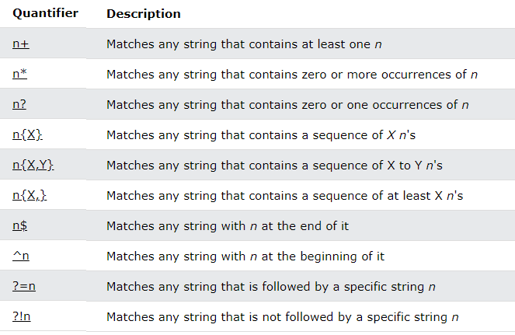

Slide 60
4.12 Pattern Matching (continued)
- Anchors: specify a pattern match at a particular position in a string
- The pattern can be forced to match only at the left end (starts with) with caret (^); at the end with $
e.g., /^Lee/
matches "Lee Ann" but not "Mary Lee Ann"
/Lee Ann$/
matches "Mary Lee Ann", but not "Mary Lee Ann is nice"
- The anchor operators (^ and $) do not match characters in the string
they match positions, at the beginning or end

Slide 61
4.12 Pattern Matching (continued)
- Pattern modifiers
- The i modifier tells the matcher to ignore the case of letters
/oak/i matches "OAK" and "Oak" and …
- The x modifier tells the matcher to ignore whitespace in the pattern
Example: /\d+ \s [A-Z][a-z] + /x
Address with street# space then street name space is allowed to appear in string

Slide 62
4.12 Pattern Matching (continued)
Other Pattern Matching Methods of String
replace(pattern, string)
Finds a substring that matches the pattern and replaces it with the string (g modifier can be used)
g : replace every occurrence
var str = "Some rabbits are rabid";
str.replace(/rab/g, "tim");
str is now "Some timbits are timid“

Slide 63
Example
var list="This is a test about patterns"
var list2=list.replace(/\w{4,}/,"xxx");
var list3=list.replace(/\w{4,}/g,"xxx")
document.write(" list1="+list);
document.write("<br/> list2="+list2);
document.write("<br/> list3="+list3);
var phone ="98765432";
document.write("<br/> phone ="+phone);
var phone2=phone.replace(/\d{6}/,"xxxxxx")
var phone3=phone.replace(/\d{6}$/,"xxxxxx")
document.write("<br/> Your phone ends="+phone2);
document.write("<br/> Your phone starts="+phone3);

Slide 64
4.12 Pattern Matching (continued)
match(pattern)
The most general pattern-matching method
Returns an array of results of the pattern- matching operation
With the g modifier, it returns an array of the substrings that matched
Without the g modifier, first element of the returned array has the matched substring, the other elements have the values of $1, …
var str = "My 3 kings beat your 2 aces";
var matches = str.match(/[ab]/g);
- matches is set to ["b", "a", "a"]
var matches = str.match(/\d/g);
- matches is set to [3, 2]
→ SHOW forms_check.js

Slide 65
Example
var list="This is a test about patterns"
//find words with at least 4 characters
var words4=list.match(/\w{4,}/g);
for(var w of words4)
document.write("<br/> "+w);

Slide 66
split(parameter)
"," and /,/ both work as parameters
Split string into substrings and return array
Example:
Var str = “grapes: apples: oranges”;
Var fruit = str.split(/:/);
Result is array:
fruit = (“grapes”, “apples”, “oranges”)

